Slide 1


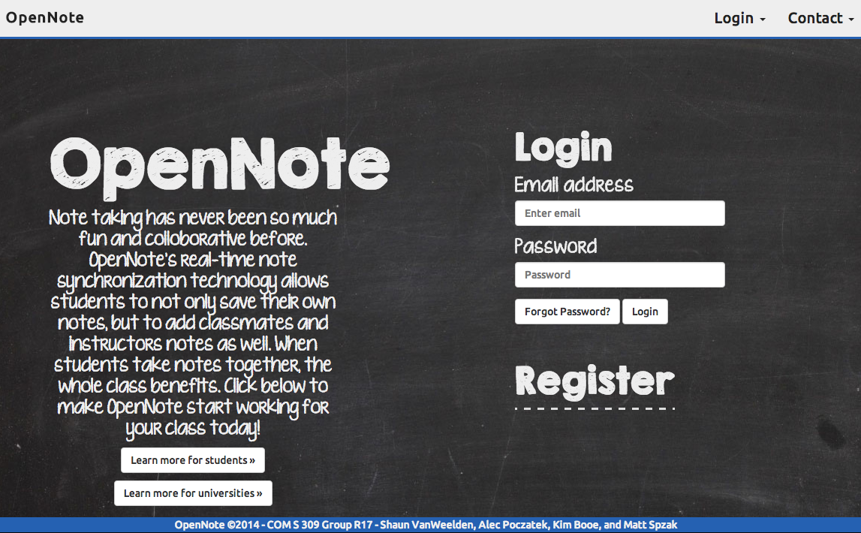
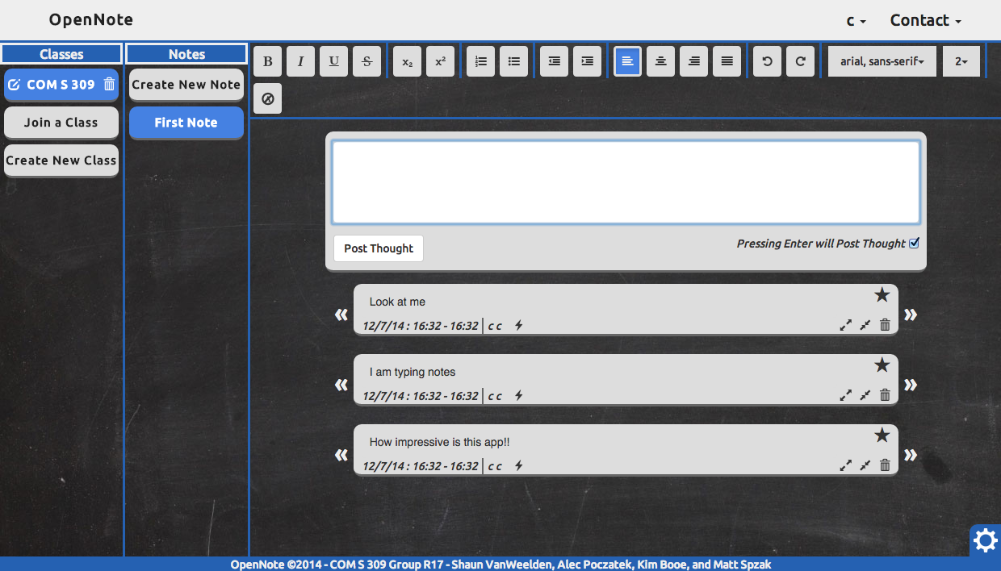
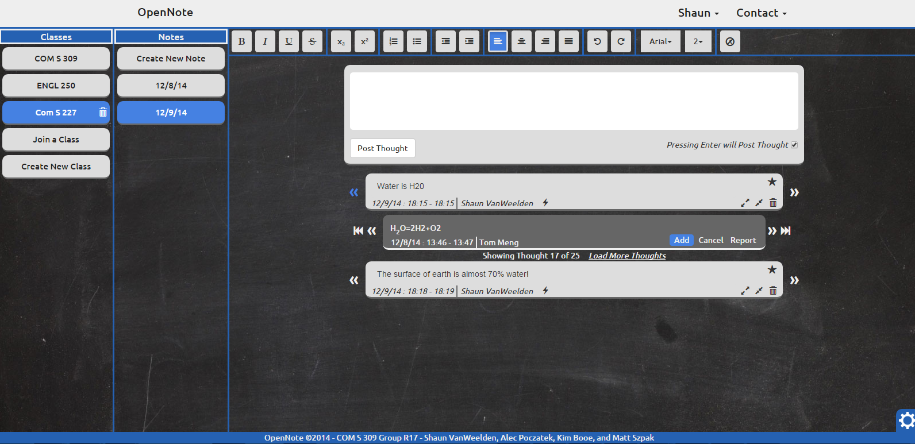
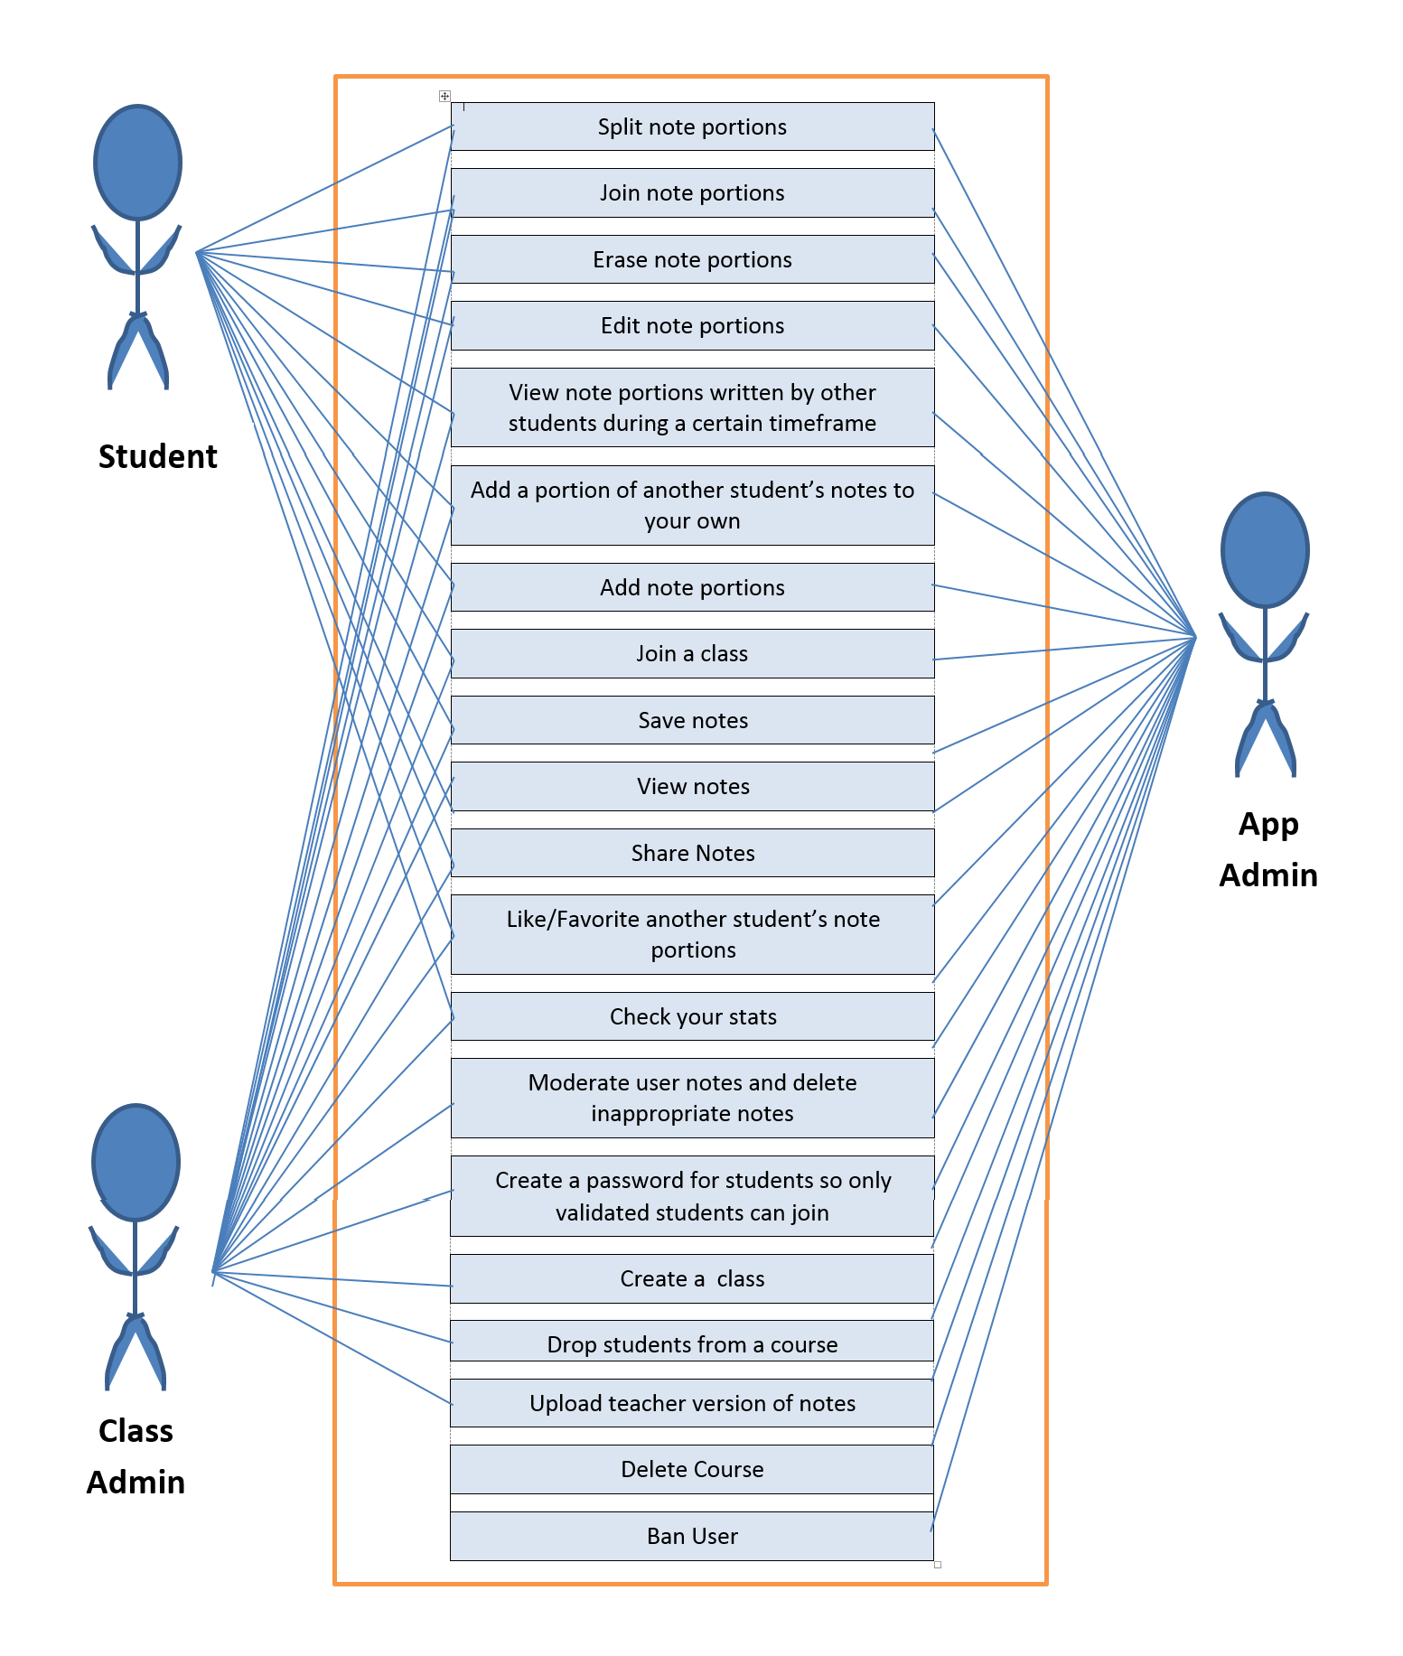
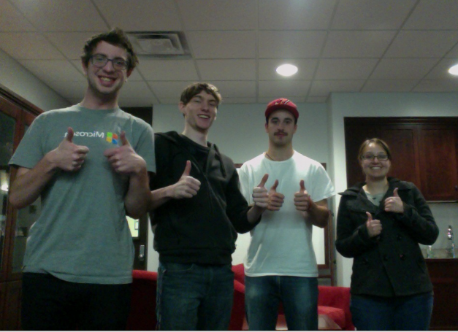
COM S 309 – Group R17
Kim Booe
Shaun Van Weelden
Matthew Szpak
Alec Poczatek
Overview
Use Cases
OpenNote brings taking notes in class to a whole different level! Not only do you have an easy way to take notes yourself, you now have an easy way to share those notes with your peers. Picture this, you are sitting in class taking notes when you realize you have totally spaced out and missed the last five minutes of discussion. You try and ask your neighbor to see what they wrote, but now you and your neighbor are even more distracted! OpenNote solves this issue and many more! We do real-time synchronization of your notes with the notes of your classmates so you can go back and review what notes your classmates were taking and add those notes to your own.
Taking notes online has other advantages too! You can create virtual flashcards in a single step, have full access to text formatting, and create helpful study guides in seconds.
As we developed OpenNote, we focused on a few key use cases
Creating an Account
OpenNote makes it extremely easy to register new accounts. We ask each user to provide their basic contact info such as their name and email, and then we ask what university they attend. Since OpenNote is collaborative note taking for classes, we have to know what university the user attends so we know what classes they are able to join.
Creating Classes
Anyone can create a new class for others to join. Creating a new class is easy, the user simply has to supply a class name, the instructor name, and then the term and year the class is offered. After creating a class, other students attending the same university will be able to search for and join your class!
Taking Notes
Great note-taking is at the heart of OpenNote. First, a student will select which class they wish to take notes for. If they are already enrolled in classes, it will load the first class automatically. Secondly, they can make a new note sheet, this sheet can be divided by lecture date, textbook chapter, or whatever the user would like.
Once a note sheet has either been selected or created, the user can begin typing notes. We give them a full-blown HTML text editor to create rich formatted notes on the fly. We automatically separate the notes you type into thoughts. These thoughts are what is shared with your classmates amongst many other things. You always go back and modify existing thoughts, merge them together, split them apart, or delete them.
Sharing
We have made it as easy as possible to share notes with classmates! When you post a thought to your note sheet, it becomes available for classmates to add to their own note sheets. Similarly, you can use the left and right arrows surrounding each of your thoughts to browse notes classmates have submitted before and after you had that thought. We also have the ability to report and remove abusive thoughts.
Studying
We have two major things developed to help you study. The first is the ability to turn any thought into a flashcard. Simply click the lightning icon and it will flip your thought over and allow you to write a hint for the thought content. Flip back and forth and make memorization a breeze!
Secondly, we made it easy to favorite your most helpful thoughts. Easily print any thought that has been “starred” to create printable study guides any time.
Administer Classes
If you created a class at your university, you are the administrator of it. As the administrator, you have access to see everyone in the class and all the thoughts that have been created in that class. You can easily remove thoughts or users as needed. One handy feature is to see reported thoughts at the top of the page to make removal even easier.
Screens
Actors
OpenNote consists of three different types of actors:
Student – Every user that uses the app to take notes is considered a student. They are the users that use the app to keep their ntoes organized and work together collaboratively with other students to create the best possible notes.
Class Creator – The user that has originally created the class. This user is able to remove users from their class, as well as delete the class they created if they like.
Login Screen
Design Decisions
In terms of overall site flow, we looked at several modern websites and realized that several of the sites simply load different parts of the page dynamically instead of making the user go to a bunch of different pages for different actions. We only have one index.html page and all the user actions either take place on the right hand side of the screen where notes are or pop up as a modal.
Due to the vey asynchronous nature of collaborative note taking, instead of using a traditional server, we used the JavaScript library Firebase to store and load all data. This worked out amazingly well because the content consistently loads and updates itself and the HTML in the background.
Document Screen
User Interfaces
The user interface for the student and class creator are one in the same. The only difference is that the class creator has more power within the app. They can manage their classes by removing users or changing the class specs/information. Below is a list of actions that each user role is allowed to do.
Adding Subthoughts
Team Info
Coming into this project, none of our group members knew too much about each other. But having spent a whole semester together we have learned a lot, and grown to become very good friends. We learned a great deal about the process involved in making an app, as well as how important communication is. It isn’t always opportune to meet for everyone so it is extremely important to split up work and collaborate often
Left to Right : Shaun VW, Alec P, Matt S, Kim B
Team R17

